Slide 1
The Entity-Relationship Model

Slide 2
Basic Database Terminology
Data model : describes high-level conceptual structuring of data
  Example: Data is set of student records, each with ID, name, address, and courses
  Example: Data is a graph where nodes represent proteins and edges represent chemical bonds between proteins
Schema describes how data is to be structured and stored in a database
  Defined during creation of the database
  Schemas rarely change
Data is actual “instance” of database
  Updated continuously
  Changes rapidly

Slide 3
The Importance of Data Models
Data model
  Relatively simple representation, usually graphical, of complex real-world data structures
  Communications tool to facilitate interaction among the designer, the applications programmer, and the end user
Good database design uses an appropriate data model as its foundation
CC414- Dr. Amani Saad - Database Systems: Design, Implementation, & Management, Rob & Coronel

Slide 4
Importance of Data Modeling
End-users have different views and needs for data
Data model organizes data for various users
CC414- Dr. Amani Saad - Database Systems: Design, Implementation, & Management, Rob & Coronel

Slide 5
Why Learn About Database Modeling?
The way in which data is stored is very important for subsequent access and manipulation by SQL.
Properties of a good data model:
  It is easy to write correct and easy to understand queries.
  Minor changes in the problem domain do not change the schema.
  Major changes in the problem domain can be handled without too much difficulty.
  Can support efficient database access.

Slide 6
The Evolution of Data Models
Hierarchical
Network
Relational
Object oriented
Object Relational
CC414- Dr. Amani Saad - Database Systems: Design, Implementation, & Management, Rob & Coronel

Slide 7
Business Rules (enforce Constraints)
Brief, precise, and unambiguous description of a policy, procedure, or principle within a specific organization’s environment
Apply to any organization that stores and uses data to generate information
Description of operations that help to create and enforce actions within that organization’s environment
CC414- Dr. Amani Saad - Database Systems: Design, Implementation, & Management, Rob & Coronel

Slide 8
Business Rules
Must be rendered in writing
Must be kept up to date
Sometimes are external to the organization
Must be easy to understand and widely disseminated
Describe characteristics of the data as viewed by the company
CC414- Dr. Amani Saad - Database Systems: Design, Implementation, & Management, Rob & Coronel

Slide 9
Sources of Business Rules
Company managers
Policy makers
Department managers
Written documentation
  Procedures
  Standards
  Operations manuals
Direct interviews with end users
CC414- Dr. Amani Saad - Database Systems: Design, Implementation, & Management, Rob & Coronel

Slide 10
Importance of Business Rules
Promote creation of an accurate data model
Standardize company’s view of data
Constitute a communications tool between users and designers
Allow designer to understand the nature, role, and scope of data
Allow designer to understand business processes
Allow designer to develop appropriate relationship participation rules and constraints
CC414- Dr. Amani Saad - Database Systems: Design, Implementation, & Management, Rob & Coronel

Slide 11
Purpose of E/R Model
The E/R model allows us to sketch the design of a database informally.
  Represent different types of data and how they relate to each other
Designs are pictures called entity-relationship diagrams.
Fairly mechanical ways to convert E/R diagrams to real implementations like relational databases exist.

Slide 12
Entity Sets
Entity = “thing” or object.
Entity set = collection of similar entities.
  Similar to a class in object-oriented languages.
Attribute = property of an entity set.
  Generally, all entities in a set have the same properties.
  Attributes are simple values, e.g. integers or character strings.

Slide 13
Attributes
Database Systems, 8th Edition

Slide 14
Attributes (continued)
Characteristics of entities
Required attribute: must have a value
Optional attribute: may be left empty
Domain: set of possible values for an attribute
  Attributes may share a domain
Database Systems, 8th Edition

Slide 15
Attributes (continued)
Composite attribute can be subdivided
Simple attribute cannot be subdivided
Single-value attribute can have only a single value
Multivalued attributes can have many values
Database Systems, 8th Edition

Slide 16
Attributes (continued)
M:N relationships and multivalued attributes should not be implemented
  Create several new attributes for each of the original multivalued attributes components
  Create new entity composed of original multivalued attributes components
Derived attribute: value may be calculated from other attributes
  Need not be physically stored within database
Database Systems, 8th Edition

Slide 17
E/R Diagrams
In an entity-relationship diagram, each entity set is represented by a rectangle.
Each attribute of an entity set is represented by an oval, with a line to the rectangle representing its entity set.

Slide 18
Example
name
manf
Entity set drinks has two attributes, name and manf (manufacturer).
Each drink entity has values for these two attributes, e.g. (coke, Anheuser-Busch)
drinks

Slide 19
Relationships
A relationship connects two or more entity sets.
It is represented by a diamond, with lines to each of the entity sets involved.

Slide 20
Example
name
addr
name
manf
cafes sell some
drinks.
cafes
Sells
drinks
license
Frequents
Likes
Note:
license =
drink, full,
none
Drinkers like
some drinks.
Drinkers
name
addr
Drinkers frequent
some cafes.

Slide 21
Relationship Set
The current “value” of an entity set is the set of entities that belong to it.
  Example: the set of all cafes in our database.
The “value” of a relationship is a set of lists of currently related entities, one from each of the related entity sets.

Slide 22
Example
A relationship R between entity sets E and F relates some entities in E to some entities in F.
R is a set of pairs of tuples (e, f ) where e is in E and f is in F.
For the relationship Sells, we might have a relationship set like:
cafe drink
Joe’s cafe coke
Joe’s cafe pepsi
Sue’s cafe coke
Sue’s cafe apple juice
Sue’s cafe coke Lite

Slide 23
Multiway Relationships
Sometimes, we need a relationship that connects more than two entity sets.
Suppose that drinkers will only drink certain drinks at certain cafes.
  Our three binary relationships Likes, Sells, and Frequents do not allow us to make this distinction.
  But a 3-way relationship would.

Slide 24
Example
name
addr
name
manf
cafes
drinks
license
Preferences
Drinkers
name
addr

Slide 25
A Typical Relationship Set
cafe Drinker drink
Joe’s cafe Ann pepsi
Sue’s cafe Ann coke
Sue’s cafe Ann apple juice
Joe’s cafe Bob coke
Joe’s cafe Bob pepsi
Joe’s cafe Cal pepsi
Sue’s cafe Cal coke Lite

Slide 26
Many-Many Relationships
Think of a relationship between two entity sets, such as Sells between cafes and drinks.
In a many-many relationship, an entity of either set can be connected to many entities of the other set.
  E.g., a cafe sells many drinks; a drink is sold by many cafes.

Slide 27
Many-One Relationships
Some binary relationships are many -one from one entity set to another.
Each entity of the first set is connected to at most one entity of the second set.
But an entity of the second set can be connected to zero, one, or many entities of the first set.

Slide 28
Example
Favorite, from Drinkers to drinks is many-one.
A drinker has at most one favorite drink.
But a drink can be the favorite of any number of drinkers, including zero.

Slide 29
One-One Relationships
In a one-one relationship, each entity of either entity set is related to at most one entity of the other set.
Example: Relationship Best-seller between entity sets Manfs (manufacturer) and drinks.
  A drink cannot be made by more than one manufacturer, and no manufacturer can have more than one best-seller (assume no ties).

Slide 30
Representing “Multiplicity”
Show a many-one relationship by an arrow entering the “one” side.
Show a one-one relationship by arrows entering both entity sets.
In some situations, we can also assert “exactly one,” i.e., each entity of one set must be related to exactly one entity of the other set. To do so, we use a rounded arrow.

Slide 31
Example
Likes
Drinkers
drinks
Favorite

Slide 32
Example
Consider Best-seller between Manfs and drinks.
Some drinks are not the best-seller of any manufacturer, so a rounded arrow to Manfs would be inappropriate.
But a manufacturer has to have a best-seller (we assume they are drink manufacturers).
Best-
seller
Manfs
drinks

Slide 33
Attributes on Relationships
Sometimes it is useful to attach an attribute to a relationship.
Think of this attribute as a property of tuples in the relationship set.
Sells
cafes
drinks
price
Price is a function of both the cafe and the drink,
not of one alone.

Slide 34
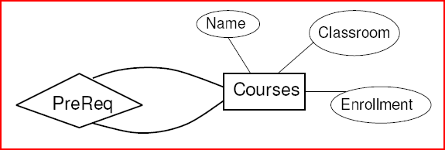
Relationships
Can the same entity set appear more than once in the same relationship?
Prerequisite relationship between two Courses
Which course is the pre-requisite?

Slide 35
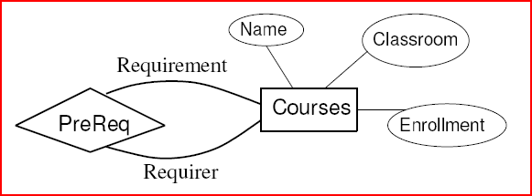
Roles
Label the edges between the relationship and the entity set with names called roles.

Slide 36
Example
Relationship Set
Husband Wife
Bob Ann
Joe Sue
… …
Married
husband
wife
Drinkers

Slide 37
Example
Relationship Set
buddy1 buddy2
Bob Ann
Joe Sue
Ann Bob
Joe Moe
… …
buddies
1
2
Drinkers

Slide 38
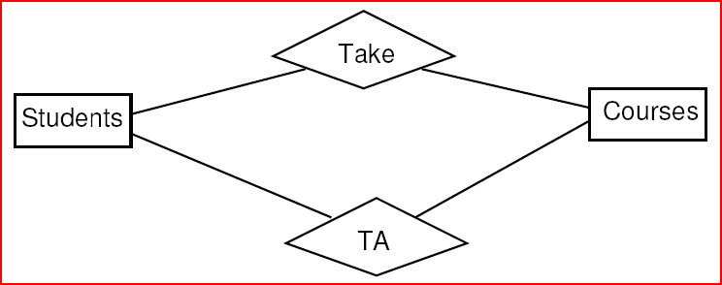
Parallel Relationships
Can there be more than one relationship between the same pair of entities?
TA and Take relationship between Students and Classes

Slide 39
Subclasses
Subclass = special case = fewer entities = more properties.
Example: Juices are a kind of drink.
  Not every drink is a juice, but some are.
  Let us suppose that in addition to all the properties (attributes and relationships) of drinks, juices also have the attribute fruit.

Slide 40
Subclasses in E/R Diagrams
Assume subclasses form a tree.
  i.e., no multiple inheritance.
Isa triangles indicate the subclass relationship.
  Point to the superclass.

Slide 41
Example
name
drinks
manf
isa
Juices
fruit

